Slide 1


e-YANTRA IDEAS COMPETITION 2020

Slide 2

AUTOMATIC SOLAR LAWN MOWER
Team ID: 933
College Name:
Reva University
Mentor Name : Dr Veena Ma’am
Team Members: Kiran N
Pradeep Shankar
Lavanya Gowda Y S
Niran N

Slide 3
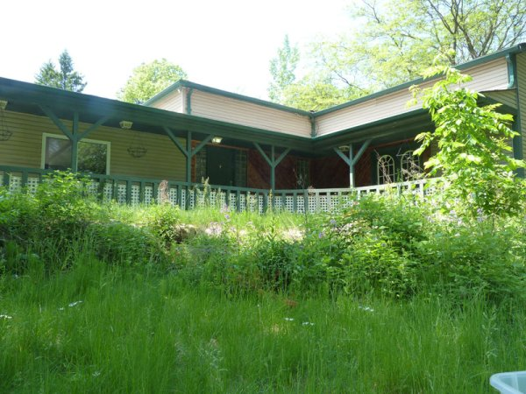
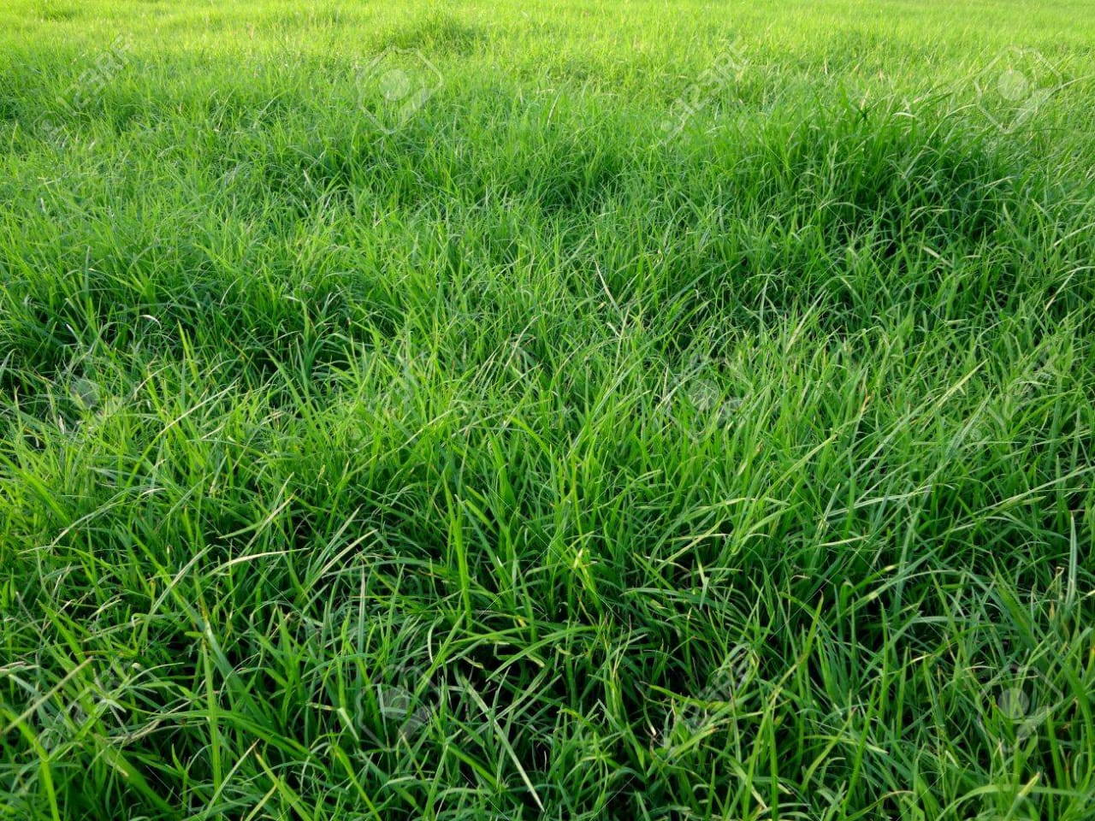
Problem Domain

Slide 4
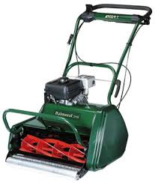
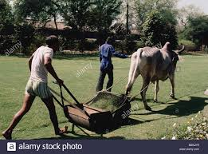
TRADITIONAL LAWN MOWER

Slide 5
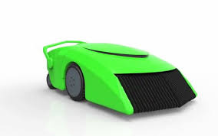
LAWN MOWER

Slide 6
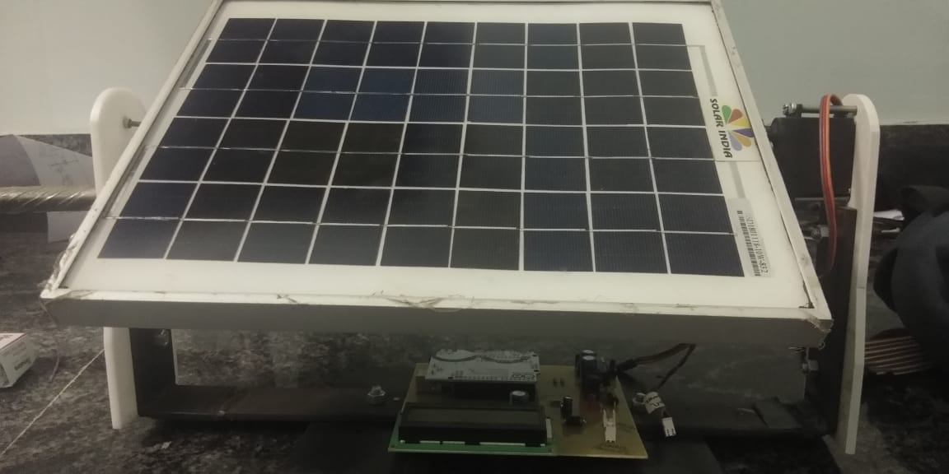
SOLAR PANEL

Slide 7
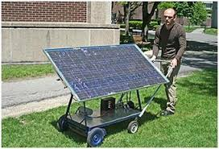
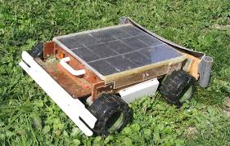
AUTOMATIC LAWN MOWER WITH SOLAR PANEL

Slide 8
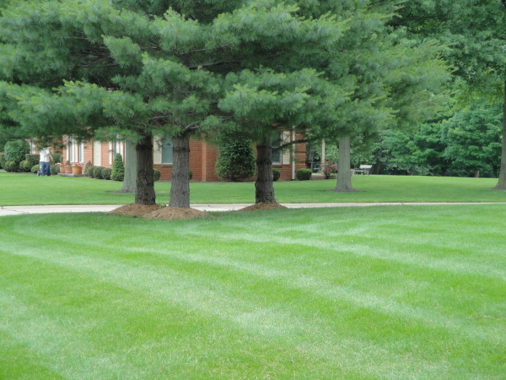

How Might We (HMW Statement)

Slide 9
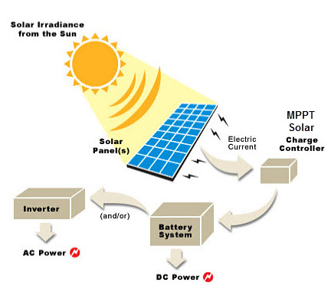
MPPT TECHNIQUE

Slide 10
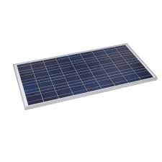
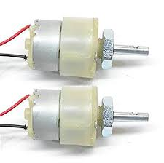
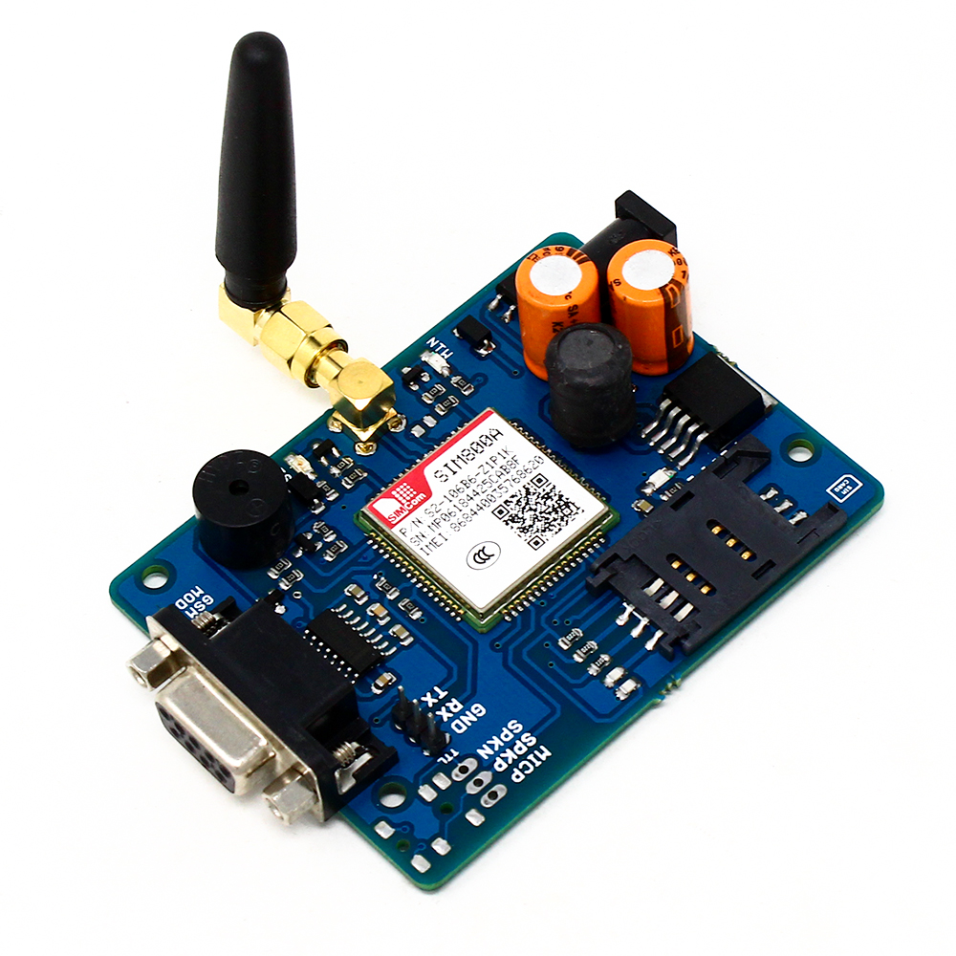
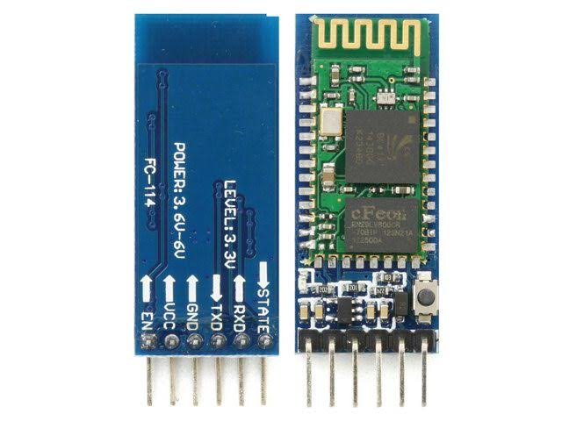
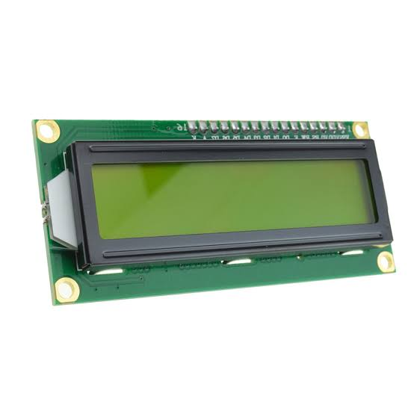
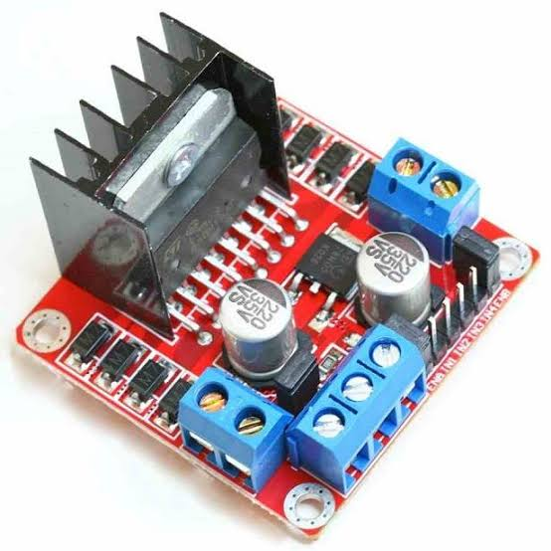
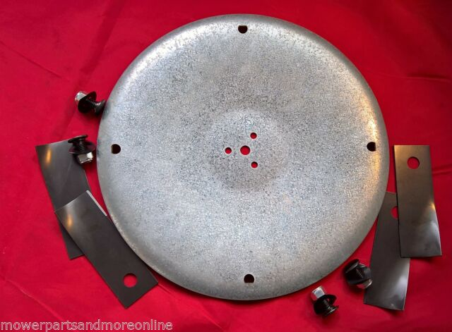
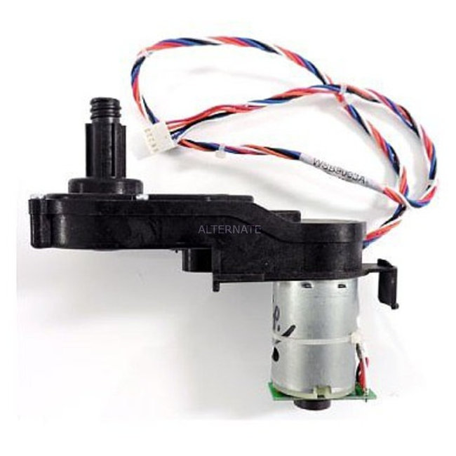
Hardware Description

Slide 11
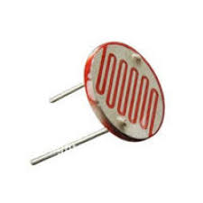
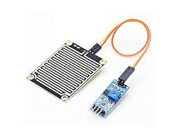
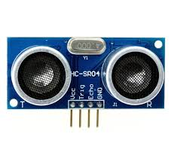
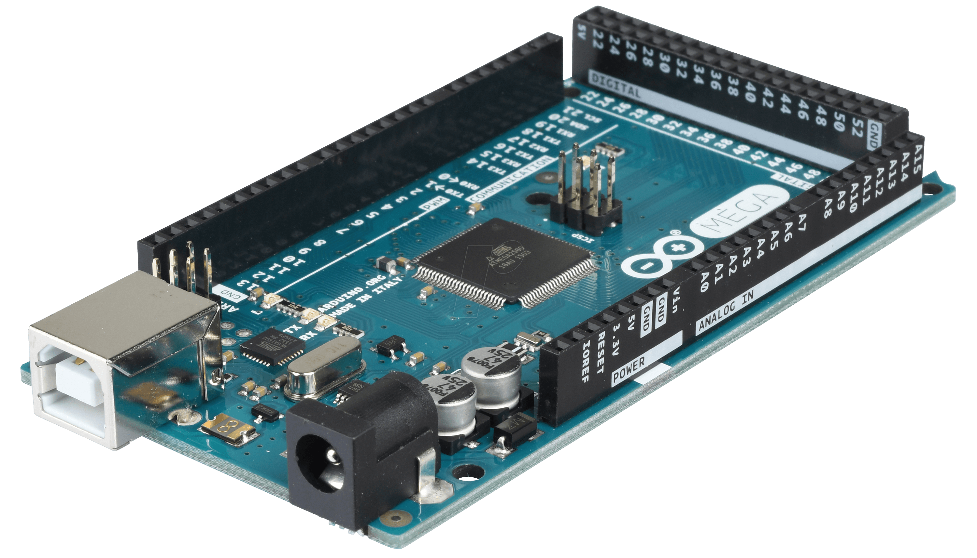
Hardware Description

Slide 12
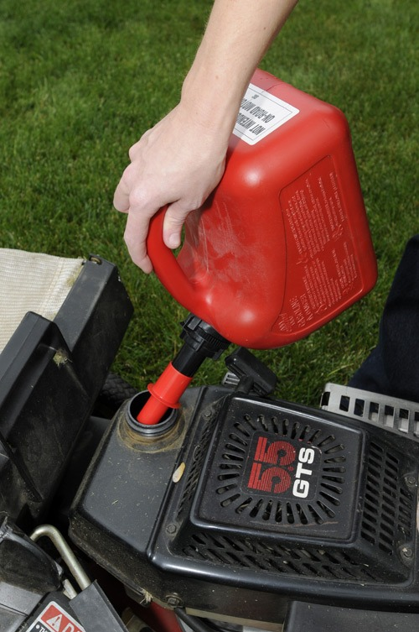
Causes - Effects

Slide 13
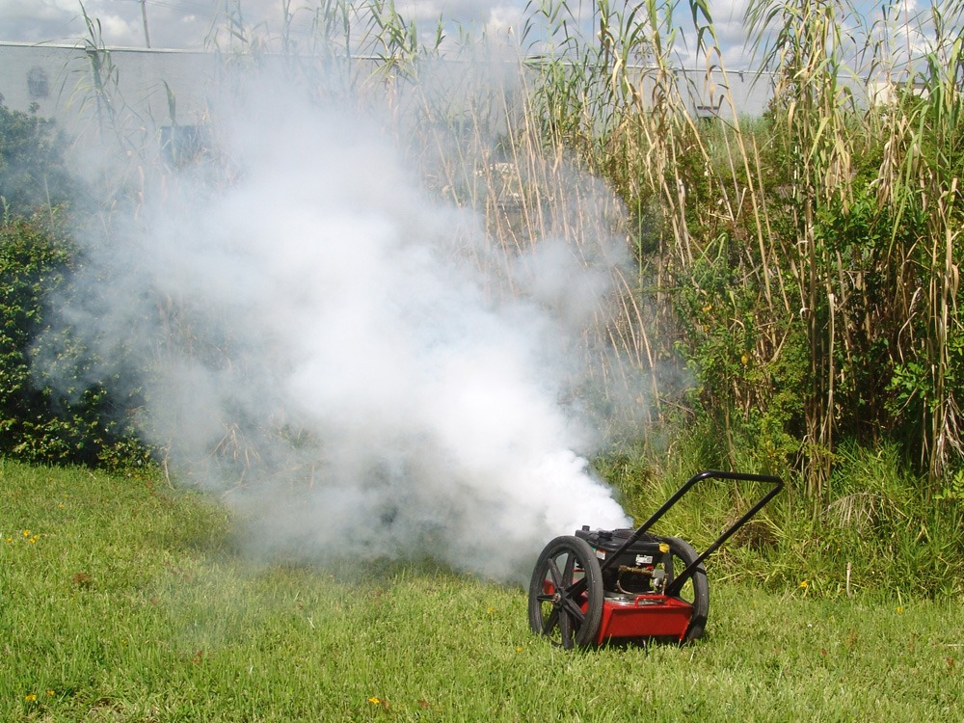
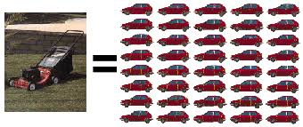
Causes – Effects

Slide 14
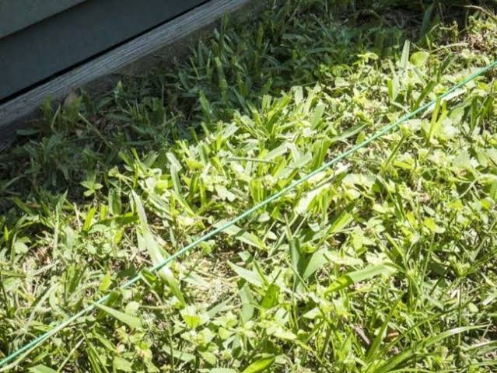
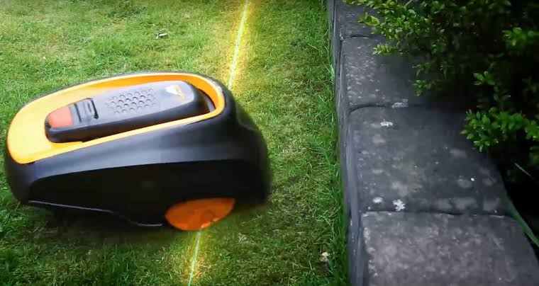
Causes - Effects

Slide 15
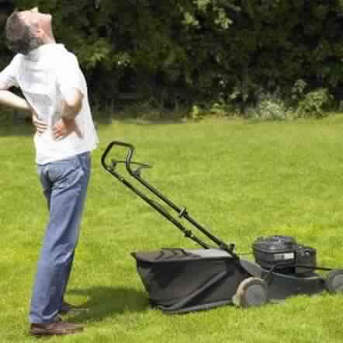
Causes – Effects

Slide 16
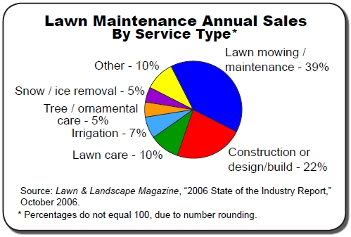
Customer and Market Research

Slide 17
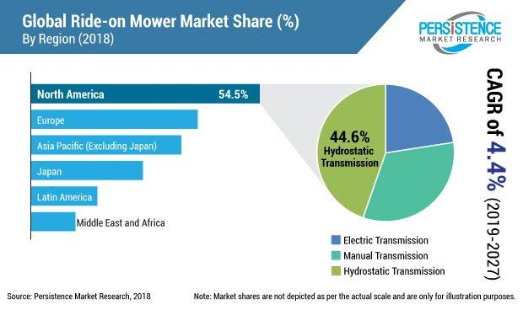
Customer and Market Research

Slide 18
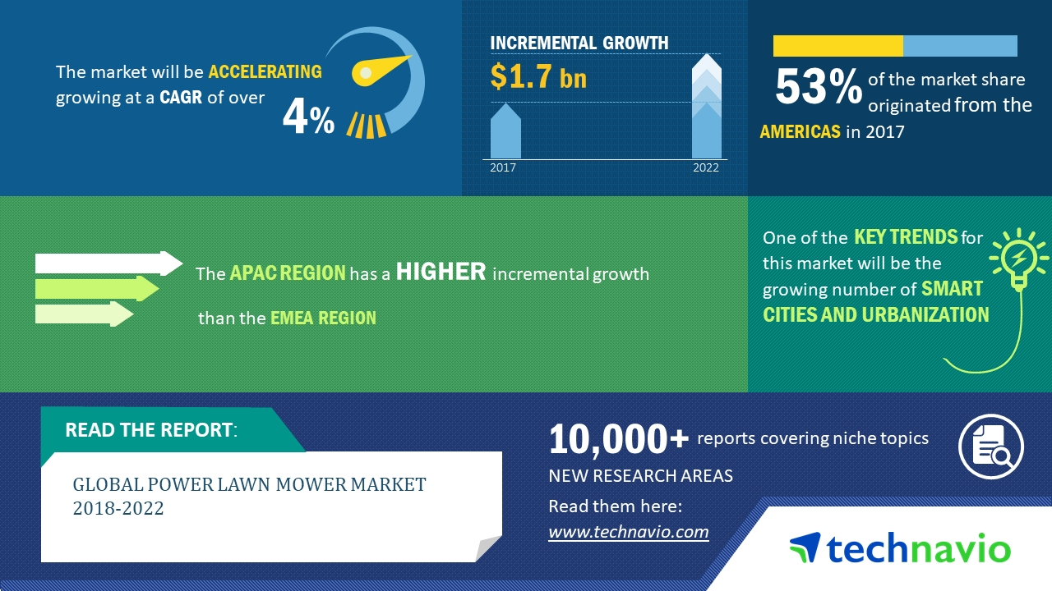
Customer and Market Research

Slide 19
Atomic Unit
Increase usage of Renewable resource.
Does not need any external power supply.
Does not emit any harmful gasses (Eco-friendly).
No messy external cable.
No supervision required.
Can be controlled manually using the app.
Increase solar energy efficiency.
Increase in working time.
Damage to objects like wires is reduced.
Solar panel set can be used in other systems.
No noise pollution.

Slide 20
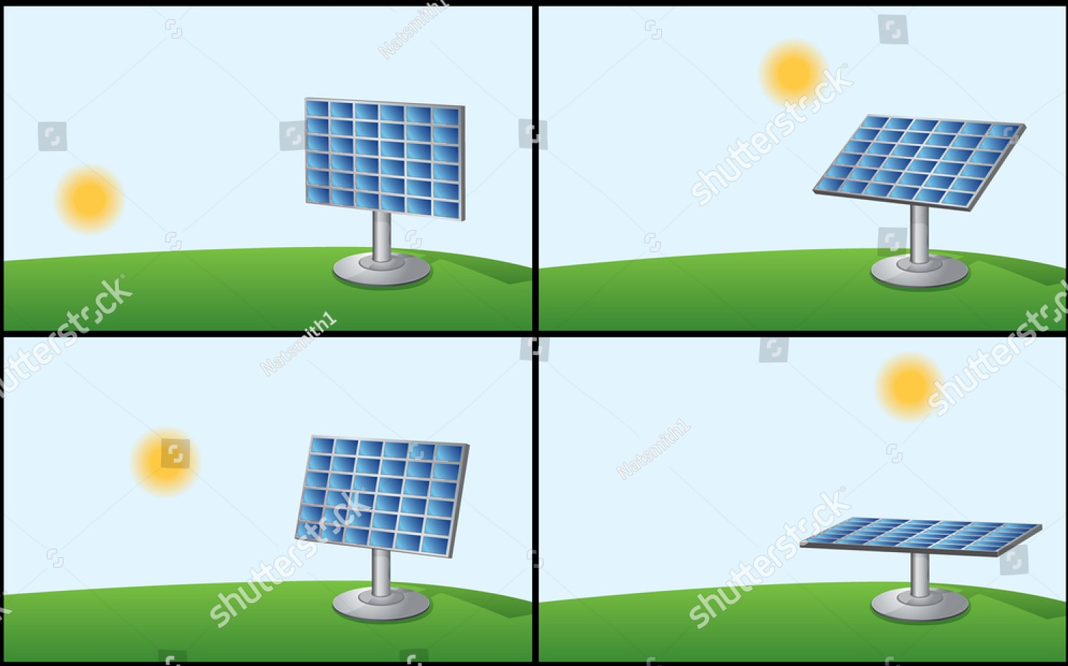
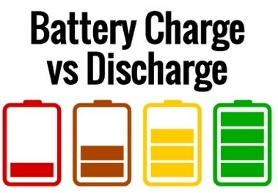
Key Performance Indicators
The solar panel rotate itself towards the direction of sun.
The charging time is decreased and the discharging time is increased by stepping up the voltage.

Slide 21
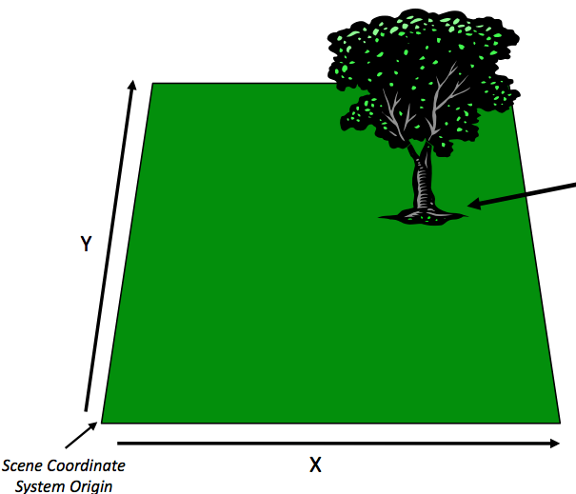
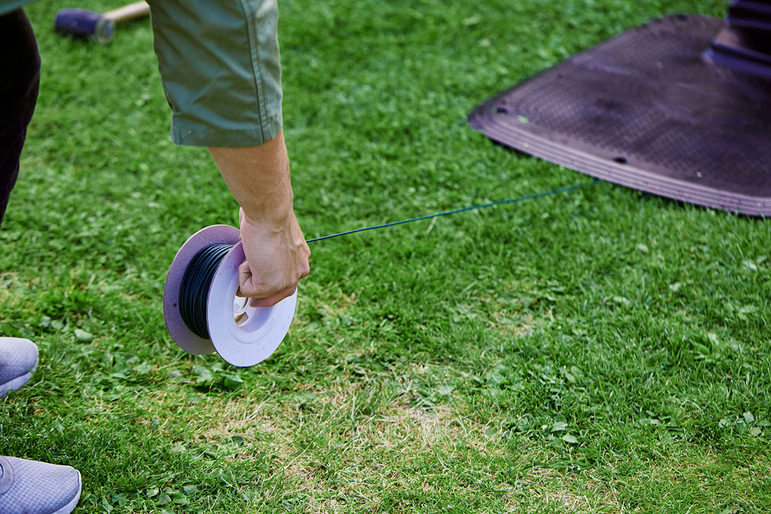
Key Performance Indicators
Coordinate system is used to find the borders of lawn so that the present environment is not disturbed.

Slide 22
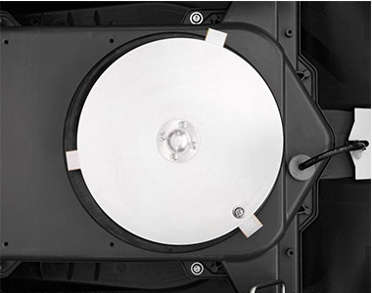

Key Performance Indicators
Laser cutting blades are used to reduce the damage to both grass on its cut edge and other objects when goes in contact with blades.
The blades used will cuts the grass into small chip which is used as fertiliser for the grass itself so no bagging required.

Slide 23
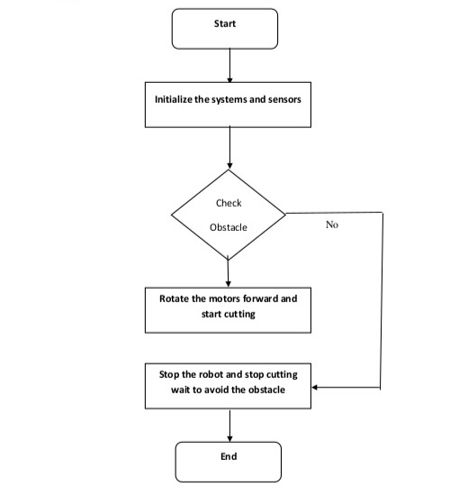
Implementation
Flow chart

Slide 24
SCOPE OF PROPOSED IDEA
In India at present there is no automatic lawn mowers so there is a high success rate and this solar panel system will be used in large scale.
Solar panel system can be even used in street lights, home appliances, etc.

Slide 25
WHY OUR IDEA SHOULD BE SELECTED?
As this project is about increasing the usage of renewable energy in large scale which the government is encouraging now a days we have high possibility of success and also reduces the time taken to mow the lawn. By all count, and with proven results, it is no wonder that this project will be success.

Slide 26
Thank You

